Slide 1
Welcome to the CIO Hour!
February 2025
Up Your Web Game in 2025

Slide 2
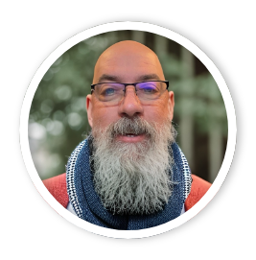
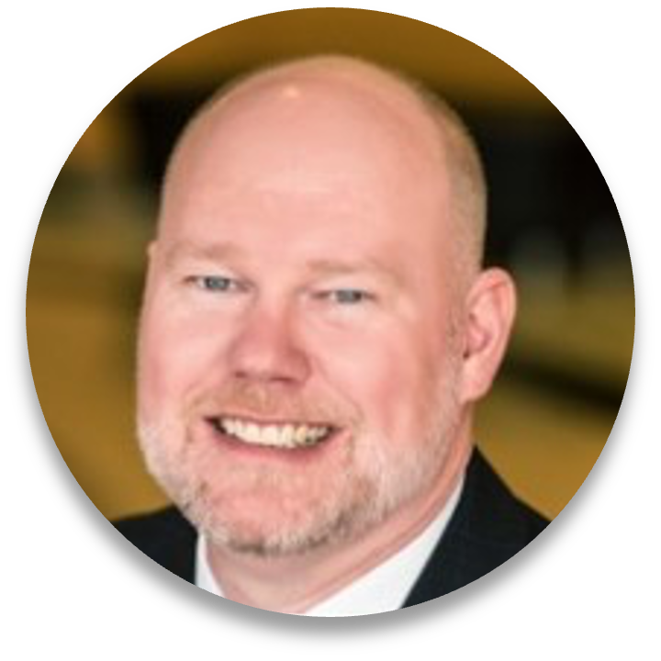
Today’s Panel
Jim Faris
Creative Director, 501Works
faris@501works.com | 703.909.1404
Jim Faris is the creative lead on design, UI and UX. With over 20 years of experience designing and developing web and marking projects for large agencies, Fortune 500 companies, and small businesses, Jim brings a history of successful design and development projects that have won him many awards including; Clio, Mimic and Hatch awards for design, development and writing. When not in front of a computer, you can find him onstage playing the upright bass, in art studios painting or out of his Vespa… when the kids aren’t climbing on his head.
JAMES C. MARQUIS
Chief Information Officer, 501Works
marquis@501works.com | 703.459.9779
James C. Marquis is a seasoned senior executive with more than 30 years of experience working in technology with a wide variety of associations and nonprofits. James’ work experience includes serving as CIO for a large medical association, CEO of a technology consulting organization and senior roles in product development and business consulting for for-profit and nonprofit clients. He also has designed and built multiple Internet-based business applications including Mojo Middleware™.

Slide 3

The CIO Hour: Up Your Web Game in 2025
Tackling the problems and questions
that are on your mind with real-world technology advice
Featuring experts in their field with decades of real-world experience
Usually the first Thursday of every month
Visit www.theCIOHour.com for upcoming topics and events.

Slide 4
Ground rules…
No question is off limits!
If the question is too specific to a particular situation, we may defer it but are happy to talk to you offline or after the event.
This is a safe space, but we understand if you wish to remain anonymous.
You may claim 1 CAE credit – details will be emailed tomorrow
Agenda
In the News – A few highlights that might interest you
Q & A – 40 min – Discussion with our experts and taking your questions
The CIO after Hour – 30 minutes of open mic discussion

Slide 5
In the News…
DeepSeek: The Chinese AI app that has the world talking
  https://www.bbc.com/news/articles/c5yv5976z9po
Leadership Fatigue: Burned Out Leaders Are Quiet Quitting At Work Too
  https://www.forbes.com/sites/dianehamilton/2025/02/03/leadership-fatigue-burned-out-leaders-are-quiet-quitting-at-work-too/
The timeline apps are here, and they’re awesome
  https://www.theverge.com/apps/605756/tapestry-reeder-surf-timeline-apps
Federal judge orders limited DOGE access to sensitive Treasury Department payment system records
  https://www.foxnews.com/politics/federal-judge-orders-limited-doge-access-sensitive-treasury-department-payment-system-records
Notes:
Encourage Curiosity over Compliance
Redefine What Leadership Success Looks Like
Normalize Rest And Recovery For Leaders
Train Managers To Lead, Not Just Manage

Slide 6
Today’s Topic:
Up Your Web Game in 2025

Slide 7
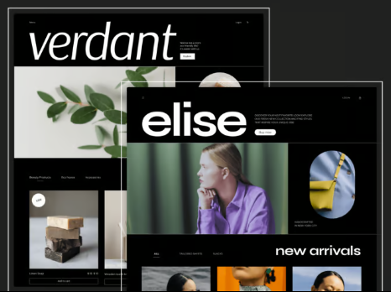
2025 Design Trends from Elementor
Micro-Interactions
Retro Style
Interactive 3D Elements
Scrapbooking
Bold Minimalism
AI-Generated Images and Videos
Dark Theme
Hyperpersonalized Interfaces
Accessibility
Sustainable Web Design
Sources: https://elementor.com/blog/2025-web-design-trends-best-practices/
Notes:
These are general trends – but it is important to keep in mind that your visitors will be comparing your Website to others they see in their Web travels.
Break out a couple of slides following this one with trend examples. Perhaps cut to a few trends in action showing SoftwareMage and MojoMiddleware live.

Slide 8
On to Your Questions…

Slide 9
What is the latest layout design for home pages to keep visitors on the website longer. Video? Static images, Drop down menus? News feeds?

Slide 10
Get to the point… quickly!
  We all have pretty short attention spans
  Micro-interactions can engage the audience
  Promote the messages that are most important
  Target getting people to where they belong over specific design elements – you will never please everyone with a design
  Even items like menus can offer opportunity to grab the user’s attention
Notes:
Machine Learning and AI augmenting the human management.

Slide 11
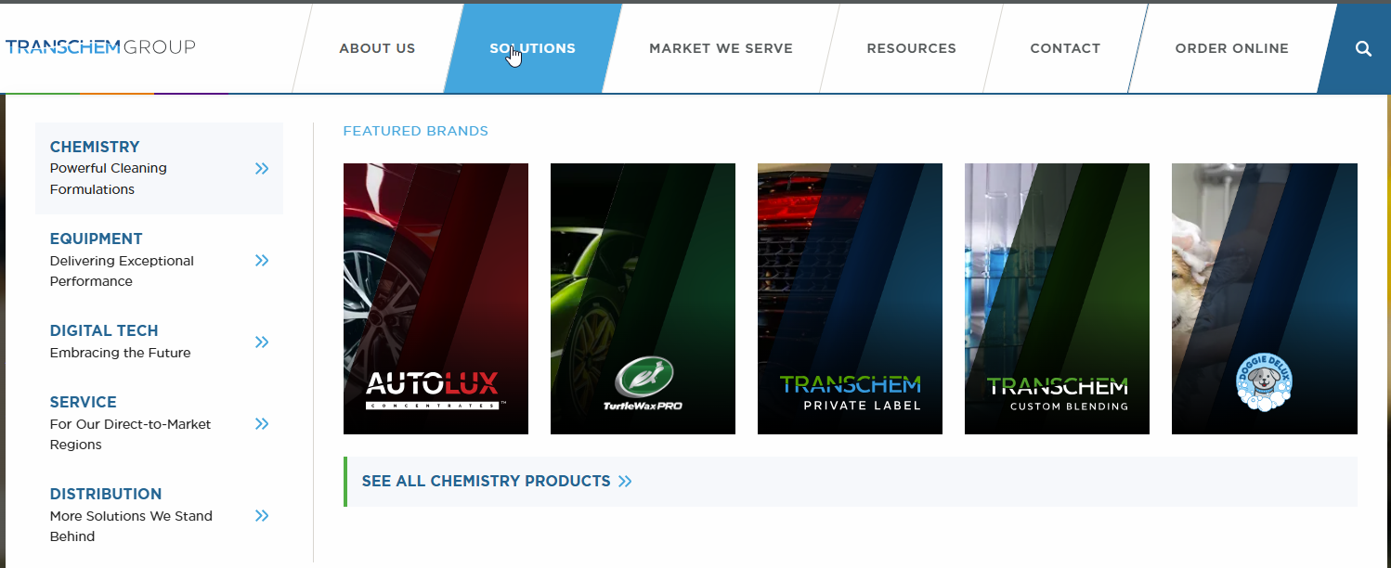
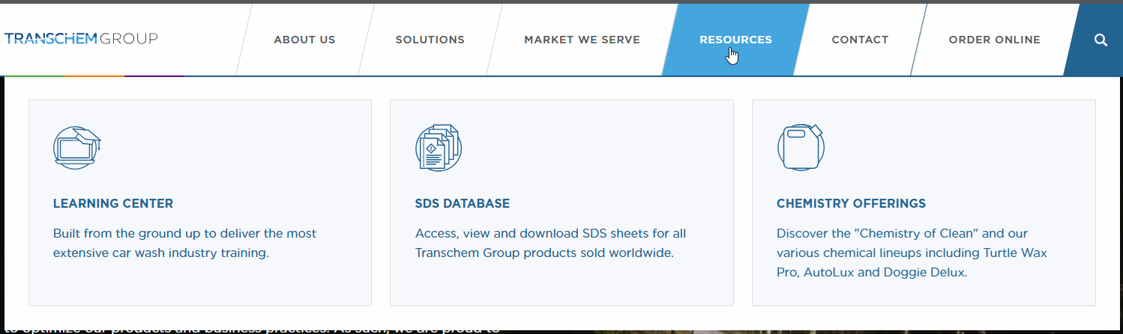
Mega Menu Examples
Notes:
Machine Learning and AI augmenting the human management.

Slide 12
Where do you find good images to use? What about using member images?

Slide 13
Finding good images is easier than you think…
  Sites like iStock, ShutterStock, Envato, and Pond5 offer tons of options.
  Font Awesome is great for iconography.
  Pexels and Pixabay have free images.
  Avoid the Google Search trap.
  Subscriptions to some of these sites can save you even more money if you use them a lot.
  Remember to get full releases (including digital rights) if you are going to use member images.
Notes:
Machine Learning and AI augmenting the human management.

Slide 14
Any tips for handling video?
Notes:
I'm working on developing an ambassador program for our members to help promote our webinars and conferences.

Slide 15
Video done right…
Video really is a special type of content because it can be VERY bandwidth intensive.
Host it right (YouTube or Vimeo) because they do the streaming work for you.
Include fallback images because video done wrong can ruin your user experience.
Notes:
There are great tools available to help manage this process…

Slide 16
How about using AI for images and video?
Notes:
I'm working on developing an ambassador program for our members to help promote our webinars and conferences.

Slide 17

AI can be a powerful tool to enhance content.
A lot of tools like Canva have AI components (and stock libraries).
Unleash your imagination (for this we used early MidJourney)
Look at services like Claud for private content enhancement.
Notes:
There are great tools available to help manage this process…

Slide 18
How do you handle accessibility issues?

Slide 19
Accessibility demystified…
Start with accessibility first! WCAG Guidelines
It is important to be inclusive and that starts with accessibility.
Up to 10% or more of users may need an accommodation.
There are tools to help evaluate your accessibility like UserWay (https://userway.org/) and Accessibe (https://accessibe.com/).
You can achieve good accessibility without compromising design.
Try the W3C free online course to get started.

Slide 20
How can personalization be used to improve the member experience?

Slide 21
Personalization is becoming an expectation…
Start with SSO (Single Sign On) which should allow you to know basic information about the user – Organization, Member Type, Certifications, etc.
Use those demographics to develop more targeted content
Most CMS platforms have ways to tie users to content once they are authenticated
Don’t forget to tie in other resources like your LMS, Community or Advocacy systems

Slide 22
What options are there for chat to improve a website?

Slide 23
Chat can be live or AI…
Options like “LiveChat” which ASAE uses can allow your staff to connect with member directly through the website during business hours
Options like “42Chat” can be trained using AI models to enhance your ability to answer high volume routine questions.
Real world example, American Pet Products trained a 42Chat bot to answer common questions about their tradeshow – it answered over 3,500 inquiries with a 95%+ answer rate

Slide 24
Why is search so hard?

Slide 25
Search can be a game changer…
Remember, Google cannot see your protected content
Tools like SOLR or Elastic with some integration and tuning can offer your users much better results than most stock solutions
Think about faceting your content (Member Directory, News, Publications, Dates, Tags) as a way to add more value
Consider how you might tease access on public pages to encourage membership

Slide 26
Any last parting advice, especially for smaller organizations…

Slide 27
Design on dime (or a few dimes)…
Sites like Fiver or Upwork have great resources if you can be very specific in asking for what you want.
Local university programs can be great places to look for resources to assemble videos.
Resources we have listed offer great graphic options that won’t break the bank.

Slide 28

Other Questions?

Slide 29
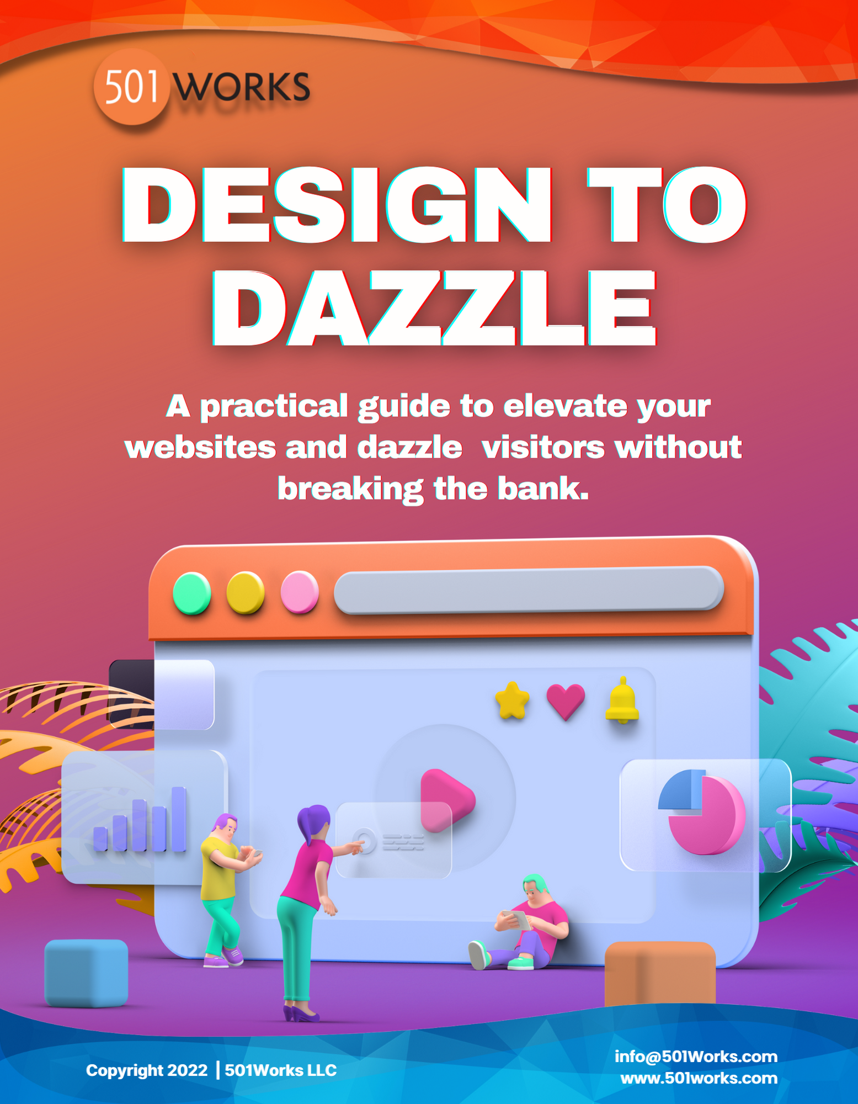
Thank you to Jim for today’s content expertise!
If you have additional questions, please contact Jim Faris:
faris@501Works.com | 703.909.1404
Just for attending today’s webinar…
Free guide –“Design to Dazzle”
Free 30-minute quick consult to review your Website and consult our experts.

Slide 30

Help Fellow Execs Find Their Perfect Match!
Visit ReviewMyAMS and submit a review of your AMS platform.
Help fellow executives make informed decisions.
Drive change with AMS vendors.
Research potential solutions for your organization.
PLUS
You get a chance to win a $50 Amazon gift card.
https://www.reviewmyams.com

Slide 31

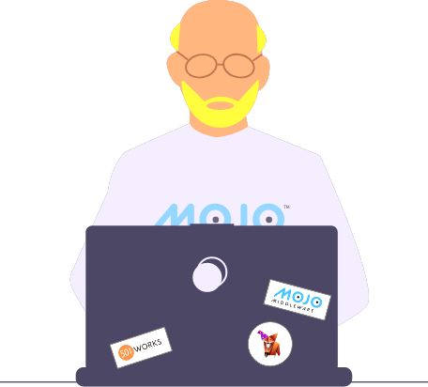







• IT Consulting Services – vCIO Service
• Software Selection & Implementation Services
• Customized Software Solutions and Integrations
CONSULTING
We are here to help!
Call or email us for a 30 minute free consulting session
Mojo Middleware™ - Easily integrate your different association software packages with over 40 available connectors.
INTEGRATION
703-459-9779
marquis@501works.com
theCIOHour@501works.com
Software Mage™ – Online tools helping you navigate the AMS/CRM selection process, gather requirements, draft your RFP, and evaluate vendor responses.
SOFTWARE
501works.com
theCIOHour.com

Slide 32
Final Thoughts
Join us March 6th for Integrations – The Ups & Downs
An archive of this presentation and today’s Webinar will
be posted on theCIOHour.com in a few days
Any suggestions for future programs? Topics you would like
to see covered? Please email us: theCIOHour@501works.com
For CAE credit – you will receive a link via email tomorrow so
you can claim your credit and receive your certificate

